Slide 1

ASP.NET Core Security
Damien Bowden Microsoft MVP
https://damienbod.com
@damien_bod

Slide 2





https://github.com/damienbod ASP.NET Core, OpenID Connect, OAuth, Identity, Azure Angular, angular-auth-oidc-client npm

Slide 3
Security & Applications today
OpenID Connect, OAuth2
Protecting APIs
Public / Protected APIs

Slide 4

Security & Applications today
Notes:
Explain one stop apps, reusing company AAA

Slide 5

Application
Notes:
App in one

Slide 6
Application
Authentication
Business
Authorization
Data Access
Identity
Notes:
What is Authentication?
Is the process of verifying an identity (who they say they are)
What is Authorization?
Is the process of verifying what someone is allowed to do (permissions)
What is an Identity?
User + Application

Slide 7
Application 2
Authentication
Business
Application
Authorization
Data Access
Authentication
Business
Identity
Authorization
Data Access
Identity

Slide 8
Application 2
Authentication
Business
Application
Authorization
Data Access
Authentication
Business
Identity
Authorization
Data Access
Identity

Slide 9
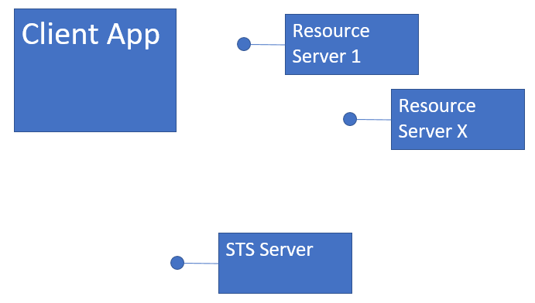

Slide 10


Slide 11
HTTPS everywhere, Certs

Slide 12
HTTPS everywhere, Certs
Protected Zone
WAF

Slide 13
HTTPS everywhere, Certs
Protected Zone
WAF

Slide 14
Authentication, Authorization, Accounting
Session Protection HTTP headers
HTTPS Certs TLS 1.2, 1.3
WAF Web Application Firewall

Slide 15
Authorization
Authentication
Session
Signout
Notes:
User with client => Identity

Slide 16
USE Standards
Don’t implement this yourself,
use certified libs, packages, tested

Slide 18
OpenID Connect
Authentication
OAuth2
Authorization
Delegated

Slide 19
OpenID Connect
http://openid.net/connect/
Standard, Specification
Authentication and Authorization
built on top of OAuth2 (access control)
Identity (Person can have n Identities)
UserInfo Endpoint
Notes:
TODO, needs to be improved

Slide 20
Open ID Connect (OIDC) is supported by almost all systems.
Azure AD, Azure B2C, OKTA, IdentityServer4,
google accounts, Openiddict, node-oidc-provider

Slide 21
Authorization
Authentication
Session
Signout

Slide 22
OpenID Connect Flows OAuth2 Flows http://openid.net/specs/openid-connect-core-1_0.html
OAuth2 Resource Owner Credentials Flow
OpenID Connect Code flow
OpenID Connect Hybrid flow
OpenID Connect PKCE Authorization Code Flow RFC 7636
OAuth Device Flow
Notes:
15 mins
Protected, trusted applications question

Slide 23
id token token (access token) reference / self contained token refresh token
scope Back-Channel Front-Channel User Agent
Notes:
id_token
Identity token for the Application
Validated, opened by Client Application
not to be used for API access
access _token
access token for APIs, Resources
Not opened, by Client Application
Implicit validation on Client using the at_hash
To be used for API access, resources.
Can by any format, not just a JWT
reference _token
random string, no defined format
references an access_token
easy to control the lifecycle
makes it possible that access_token must never leave the safe zone
refresh token
random string, no defined format
Used to refresh the tokens
Not Implicit Flow
Scope
Identity scopes
API or Resource scopes
managing your claims, grouping, APIs
OpenID scopes openid, profile, email, phone

Slide 24
OAuth2 Resource Owner Credentials Flow
MC to MC applications
trusted client
grant_type=client_credential&client_id=xxxxxxxxxx&client_secret=xxxxxxxxxx
Limited user cases

Slide 25
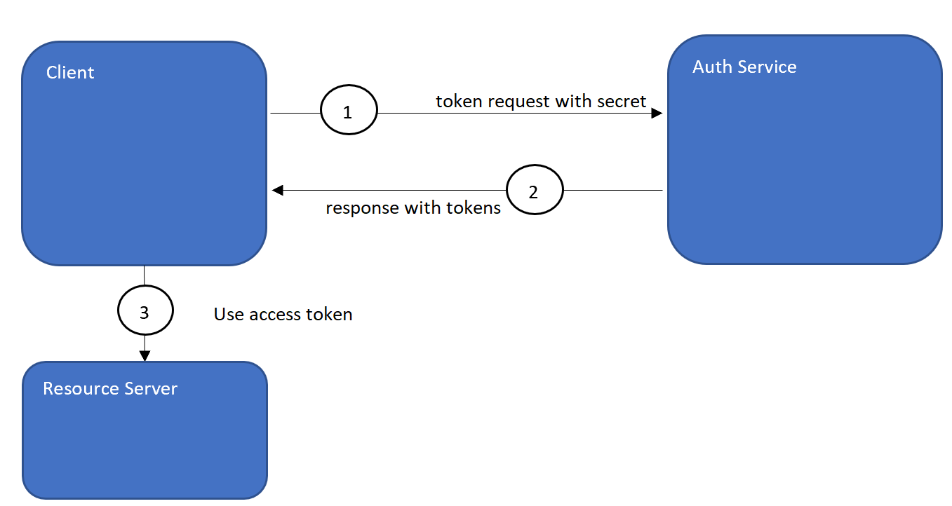
OAuth2 Resource Owner Credentials Flow

Slide 26
OpenID Connect Authorization Code flow
Server to server applications with User
Can keep secrets, is trusted
Client is authenticated
response_type = code

Slide 27
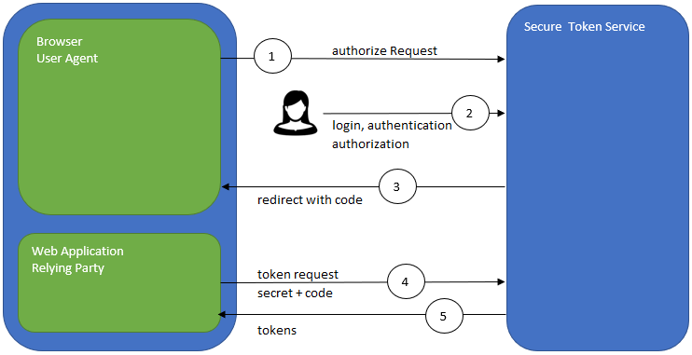
OIDC Authorization Code flow
Notes:
The Authorization Code Flow returns an Authorization Code to the Client, which can then exchange it for an ID Token and an Access Token directly. This provides the benefit of not exposing any tokens to the User Agent and possibly other malicious applications with access to the User Agent. The Authorization Server can also authenticate the Client before exchanging the Authorization Code for an Access Token. The Authorization Code flow is suitable for Clients that can securely maintain a Client Secret between themselves and the Authorization Server.
Steps:
Client prepares an Authentication Request containing the desired request parameters.
Client sends the request to the Authorization Server.
Authorization Server Authenticates the End-User.
Authorization Server obtains End-User Consent/Authorization.
Authorization Server sends the End-User back to the Client with an Authorization Code.
Client requests a response using the Authorization Code at the Token Endpoint.
Client receives a response that contains an ID Token and Access Token in the response body.
Client validates the ID token and retrieves the End-User's Subject Identifier.

Slide 28
OIDC Hybrid flow
Mix of the Code and Implicit Flow
Can be used for Web applications with server side rendering.
response_type = code id_token | code id_token token | code token

Slide 29
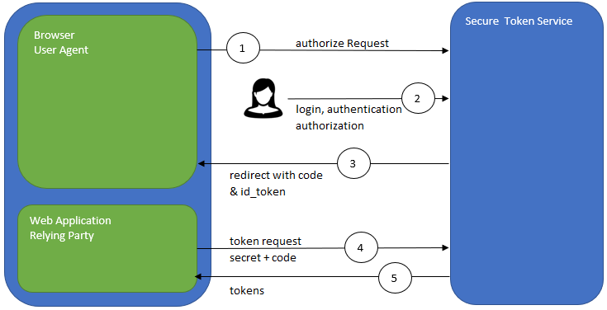
OIDC Hybrid flow
Notes:
http://openid.net/specs/oauth-v2-multiple-response-types-1_0.html
Steps:
Client prepares an Authentication Request containing the desired request parameters.
Client sends the request to the Authorization Server.
Authorization Server Authenticates the End-User.
Authorization Server obtains End-User Consent/Authorization.
Authorization Server sends the End-User back to the Client with an Authorization Code and, depending on the Response Type, one or more additional parameters.
Client requests a response using the Authorization Code at the Token Endpoint.
Client receives a response that contains an ID Token and Access Token in the response body.
Client validates the ID Token and retrieves the End-User's Subject Identifier.
code token
When supplied as the value for the response_type parameter, a successful response MUST include an Access Token, an Access Token Type, and an Authorization Code. The default Response Mode for this Response Type is the fragment encoding and the query encoding MUST NOT be used. Both successful and error responses SHOULD be returned using the supplied Response Mode, or if none is supplied, using the default Response Mode.
code id_token
When supplied as the value for the response_type parameter, a successful response MUST include both an Authorization Code and an id_token. The default Response Mode for this Response Type is the fragment encoding and the query encoding MUST NOT be used. Both successful and error responses SHOULD be returned using the supplied Response Mode, or if none is supplied, using the default Response Mode.
id_token token
When supplied as the value for the response_type parameter, a successful response MUST include an Access Token, an Access Token Type, and an id_token. The default Response Mode for this Response Type is the fragment encoding and the query encoding MUST NOT be used. Both successful and error responses SHOULD be returned using the supplied Response Mode, or if none is supplied, using the default Response Mode.
code id_token token
When supplied as the value for the response_type parameter, a successful response MUST include an Authorization Code, an id_token, an Access Token, and an Access Token Type. The default Response Mode for this Response Type is the fragment encoding and the query encoding MUST NOT be used. Both successful and error responses SHOULD be returned using the supplied Response Mode, or if none is supplied, using the default Response Mode.

Slide 30
Native App PKCE Authorization Code Flow
RFC 7636
https://tools.ietf.org/html/rfc7636

Slide 31
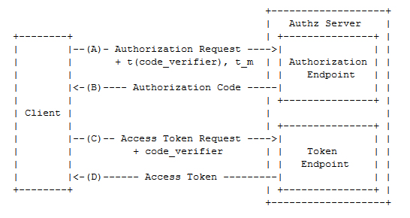

Slide 32
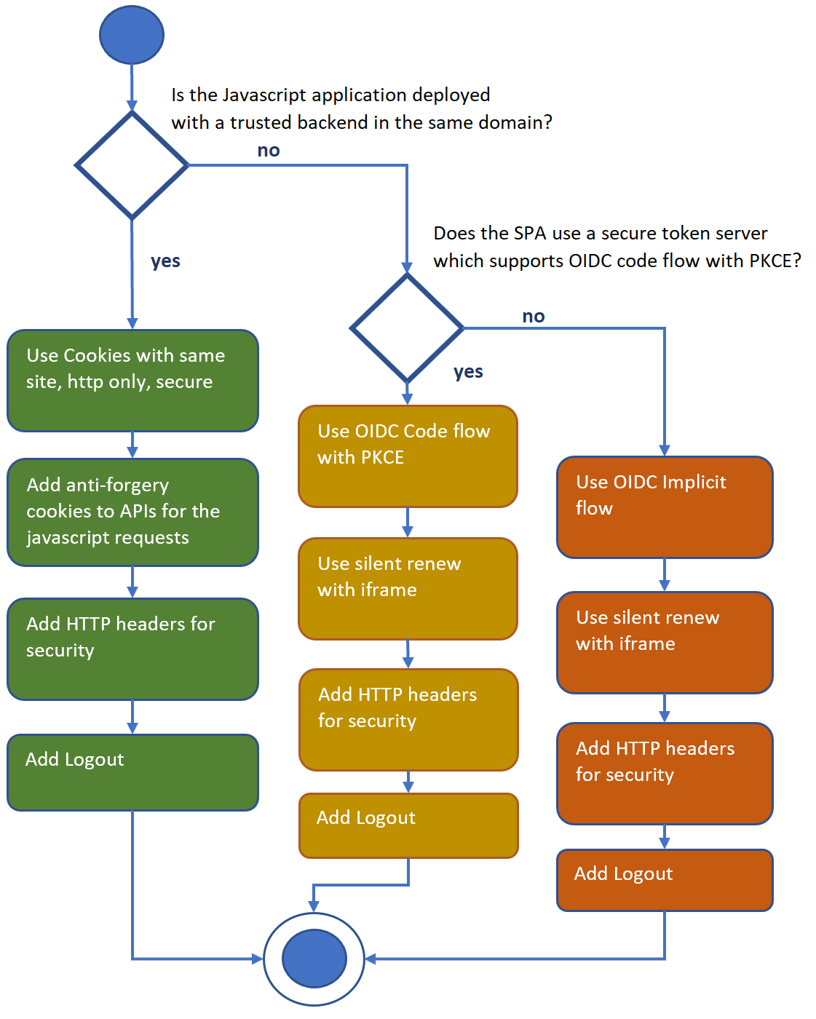
Single Page Applications
Cookies
OIDC Code Flow with PKCE
OIDC Implicit Flow

Slide 33
OpenID Connect Code flow with PKCE
For browser applications, SPAs
Client is not authenticated, or trusted
response_type = code
NO SECRET

Slide 34
OAuth Device Flow
RFC 7636
https://tools.ietf.org/html/draft-ietf-oauth-device-flow-12

Slide 35
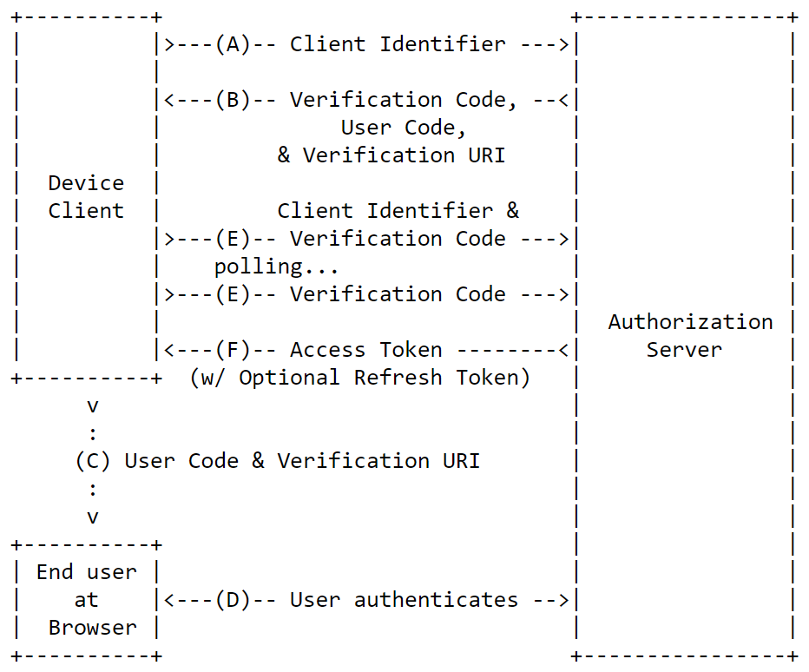

Slide 36
https://github.com/damienbod/AspNetCoreHybridFlowWithApi https://github.com/damienbod/AspNetCoreWindowsAuth
Code examples
OpenID Connect Hybrid Flow / Code Flow
Notes:
30 mins

Slide 37
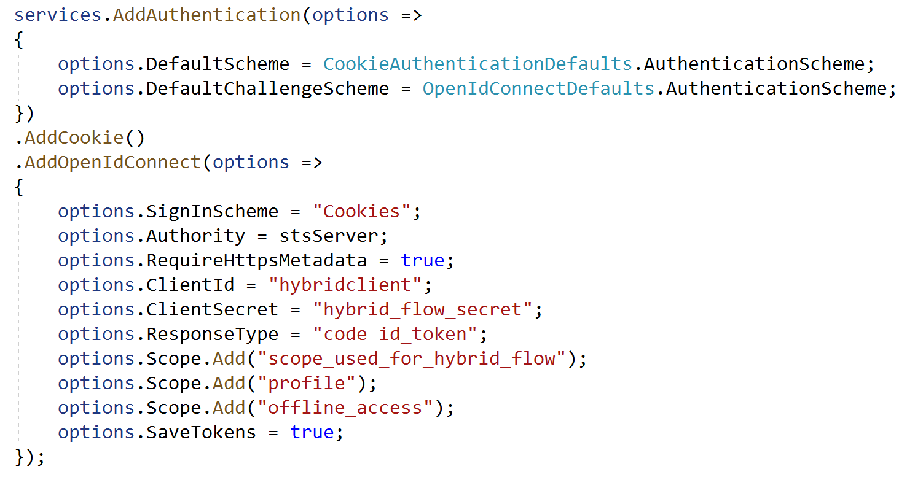

Slide 38
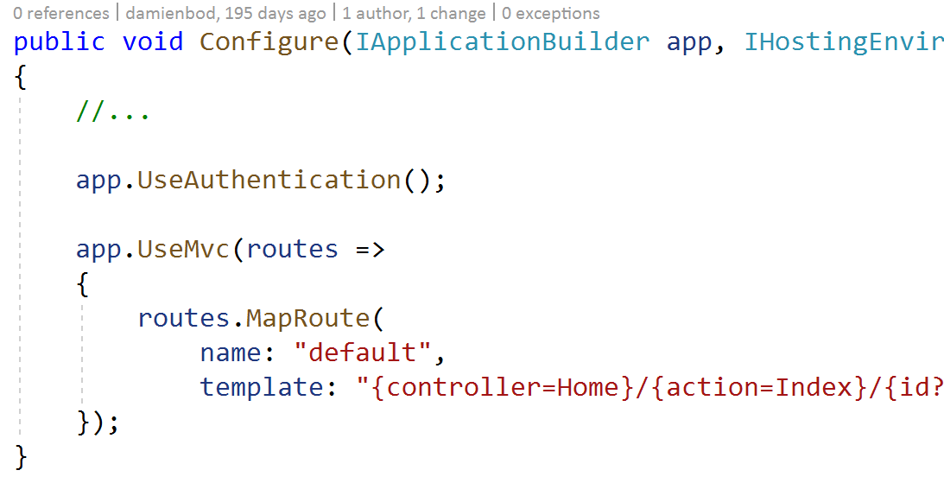

Slide 39
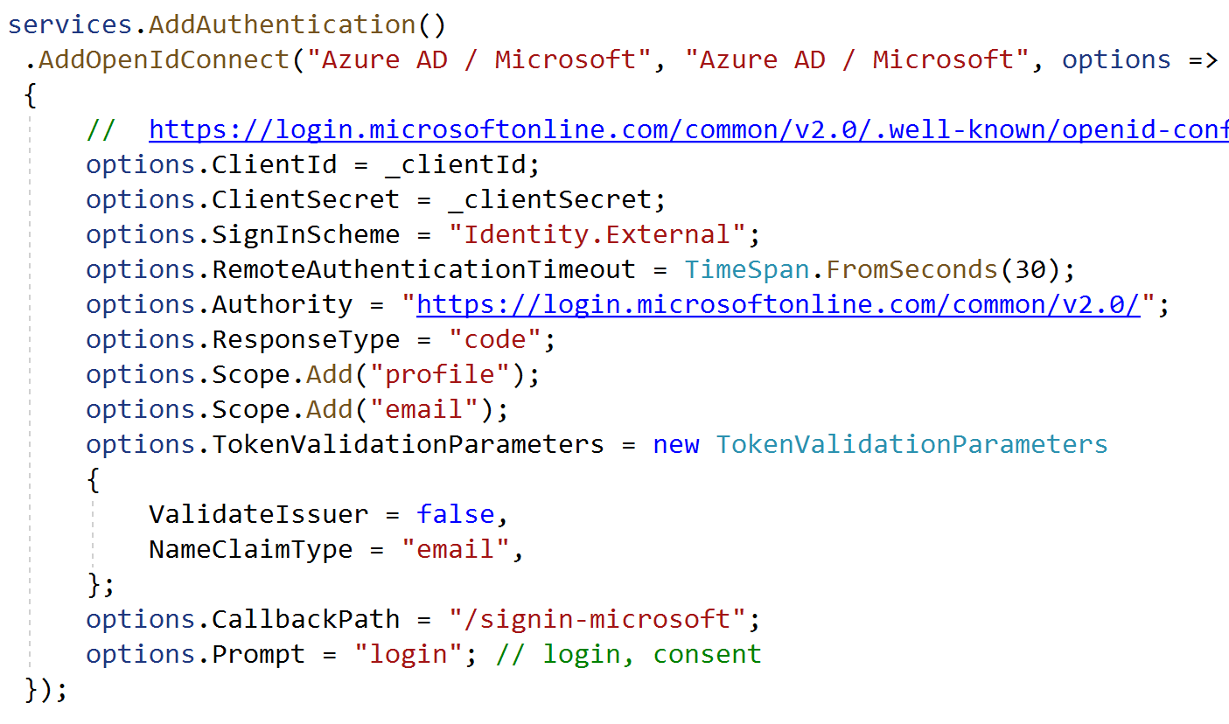

Slide 40
Protecting APIs

Slide 41
JWT Bearer Tokens Introspection Cookies

Slide 42
Self contained access tokens

Slide 43
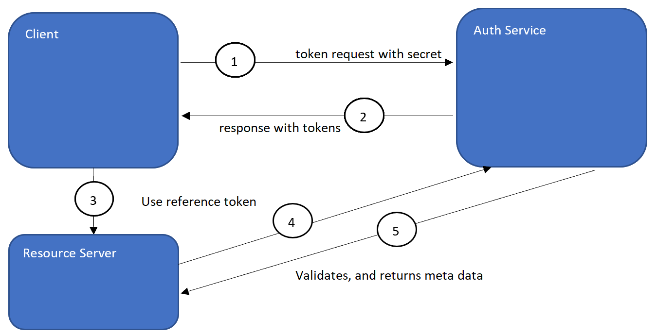
Introspection using reference tokens

Slide 44
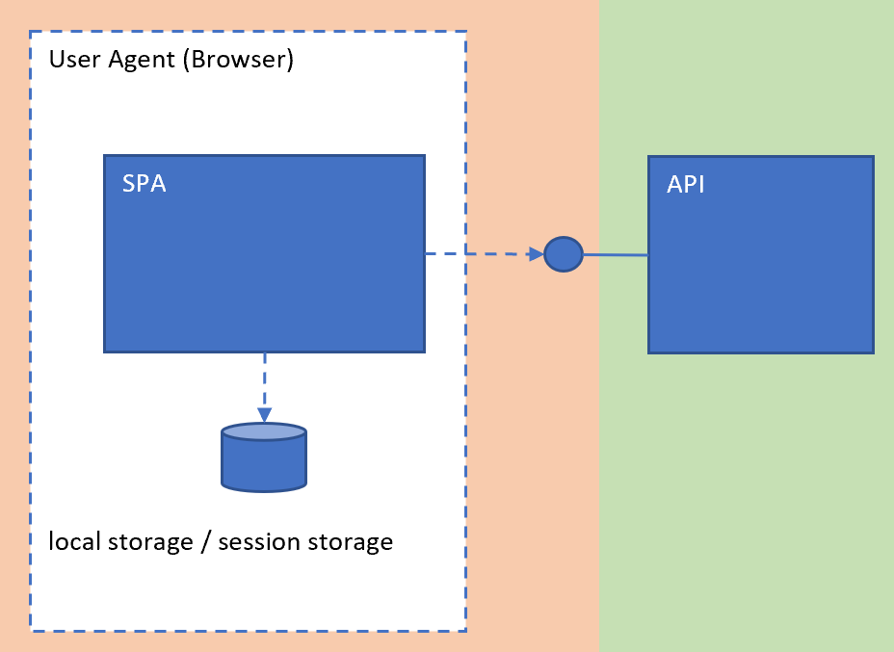
Tokens with SPAs

Slide 45
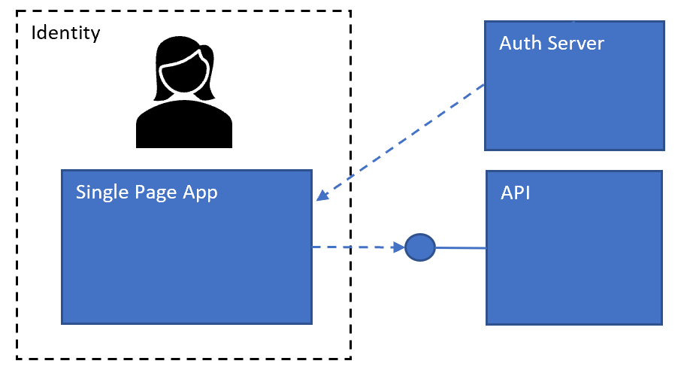

Slide 46
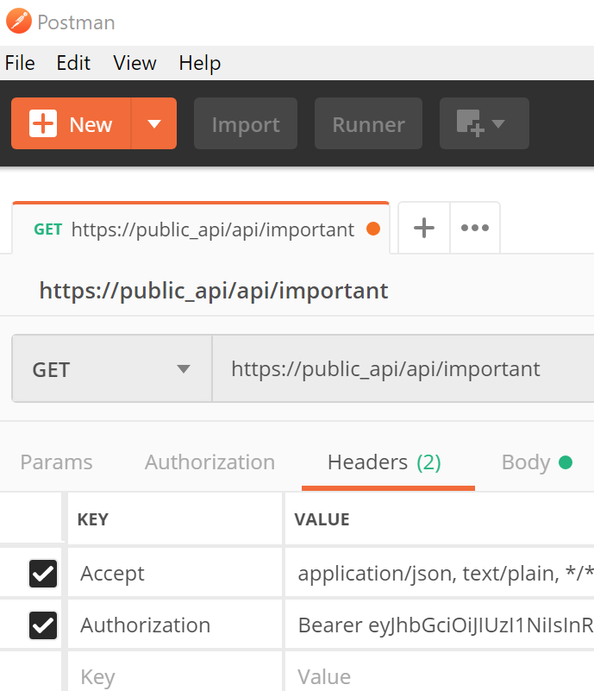
NOT the same Identity !
API

Slide 47
Can be Stateless
Problems with Web Sockets
Problems with File Download
Problem with saving tokens between requests
Tokens

Slide 48

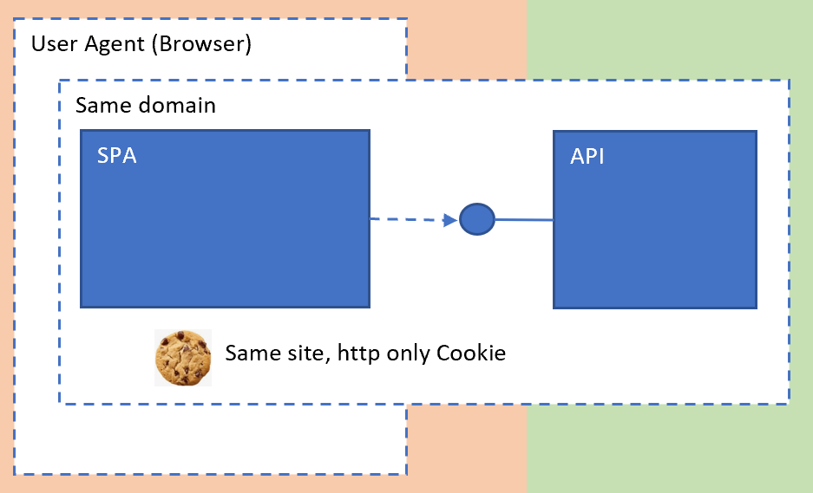
Cookies

Slide 49
Has state
__Host __Server prefixes
Same Site, HttpOnly, Secure
Anti Forgery Tokens
Use same domain
Cookies
Notes:
https://tools.ietf.org/html/draft-ietf-httpbis-rfc6265bis-03
https://developer.mozilla.org/en-US/docs/Web/HTTP/Headers/Set-Cookie
https://blog.detectify.com/2019/02/05/guide-http-security-headers-for-better-web-browser-security/

Slide 50
Public / Protected APIs

Slide 51
Public for user APP => same access token
Private Service Client separate access token to public APIs
Public API service client separate access token
Public vs private

Slide 52
https://github.com/damienbod/AspNetCoreHybridFlowWithApi https://github.com/damienbod/AspNetCoreWindowsAuth
Code examples
OAuth2 Resource Owner Credentials Flow
For trusted APPs, ie can keep a secret

Slide 53
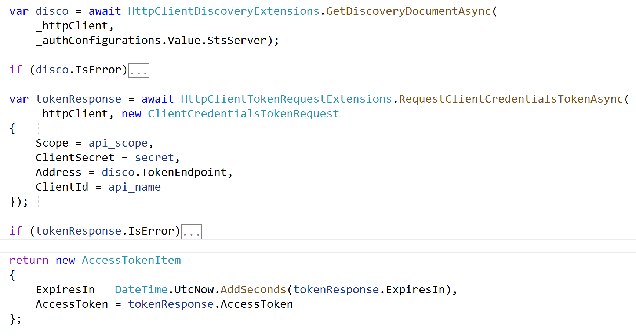

Slide 54
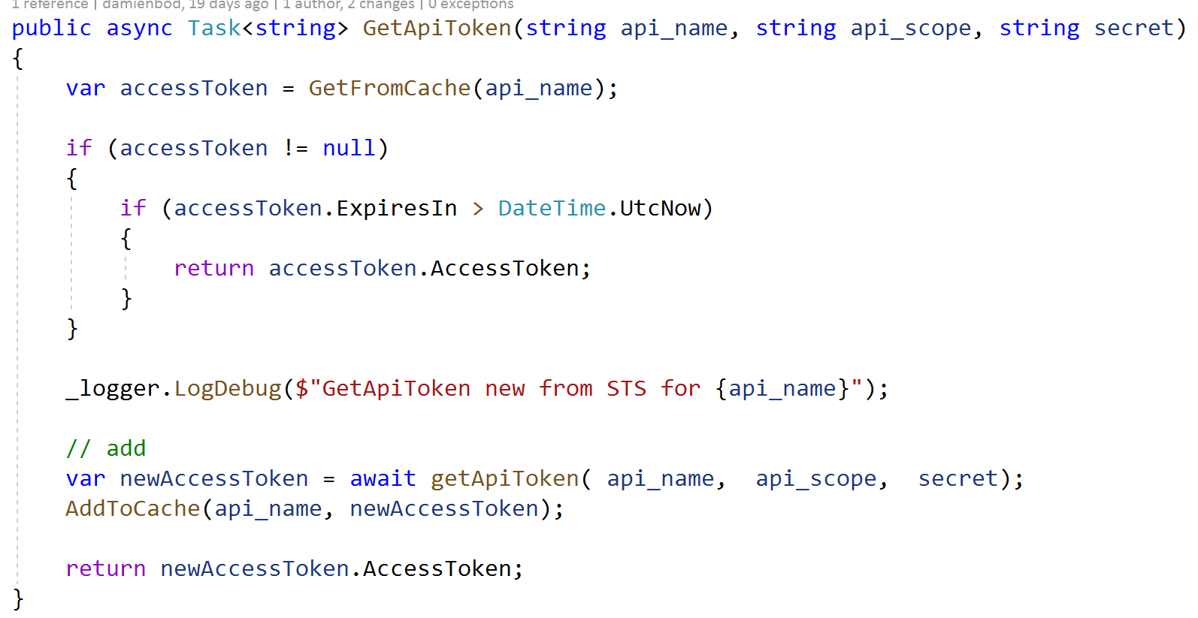

Slide 55
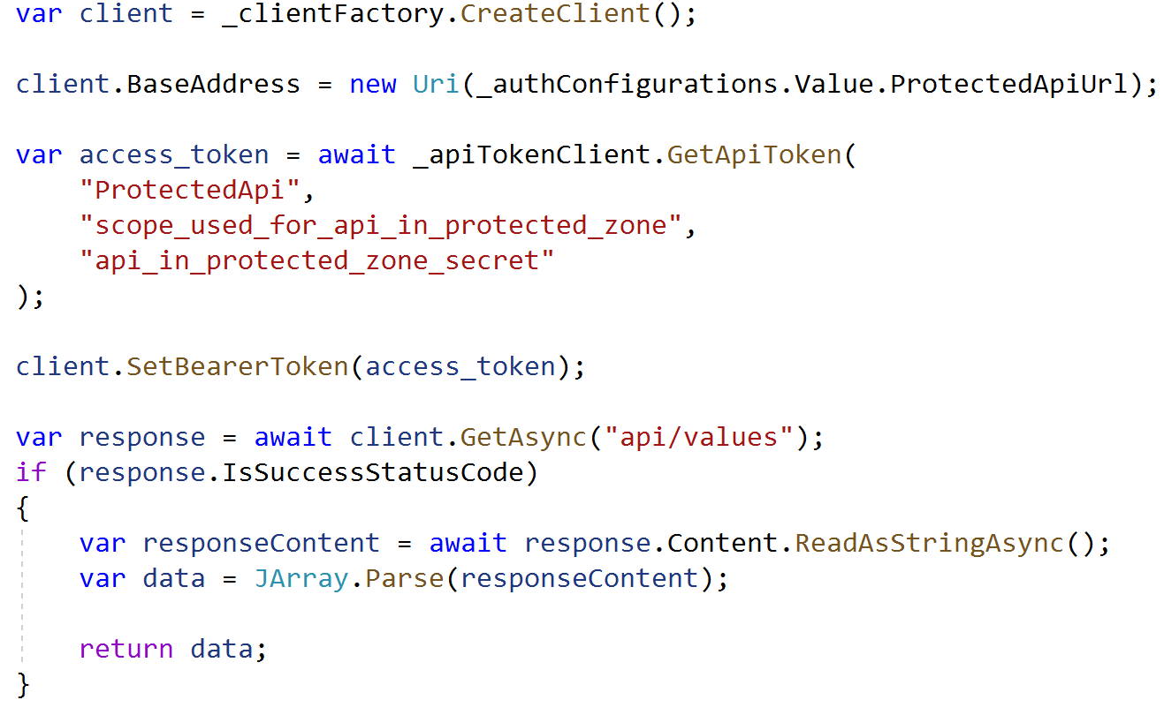

Slide 56
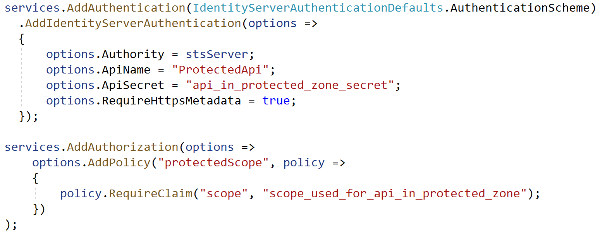

Slide 57
Thank you @damienbod

Slide 58
https://openid.net/developers/specs/
https://github.com/damienbod/AspNet5IdentityServerAngularImplicitFlow https://medium.com/@darutk/diagrams-of-all-the-openid-connect-flows-6968e3990660 https://www.npmjs.com/package/angular-auth-oidc-client
https://openid.net https://auth0.com/blog/cookies-vs-tokens-definitive-guide https://www.npmjs.com/package/angular-auth-oidc-client https://docs.microsoft.com/en-us/azure/architecture/multitenant-identity/authenticate https://scotthelme.co.uk/say-hello-to-security-txt
https://csp-evaluator.withgoogle.com/

